Slide 1

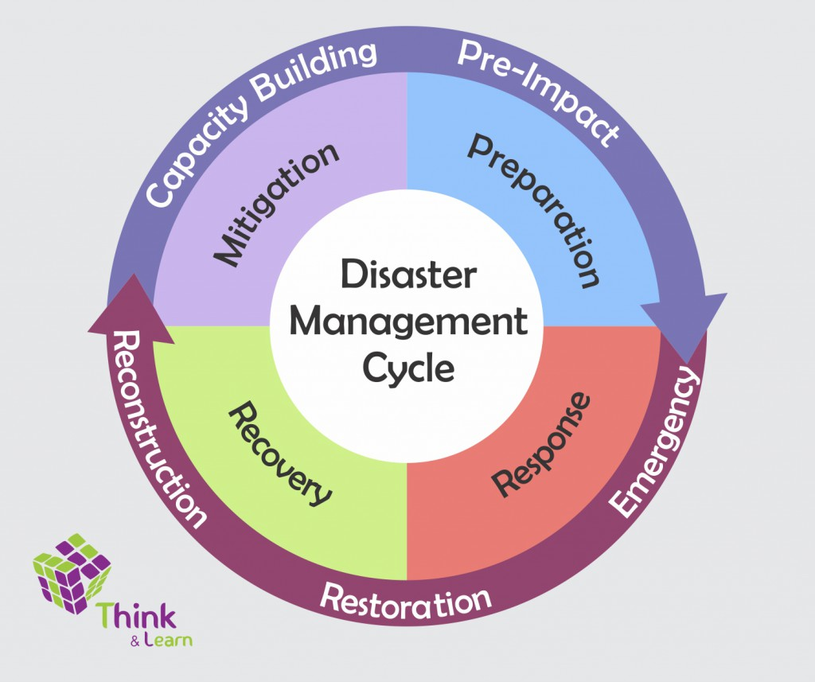
Excelsior's Coders
Team members:
Amarendar Reddy Reddygari
Haritha Kurla
Srinithya Kamareddy
Swaroop Gembali
Tilak Vinuth Nag Dhulipalla
Venkata Naga Mahesh Kumar Vankayala

Slide 2
Outline
Why new project?
Introduction to the new project
List of stakeholders
Functional Requirements
Non-functional Requirements
Methodology
Tools & Technologies

Slide 3
Outline (contd.)
Entities Involved
Demonstration
Individual Contribution
Things accomplished in this semester
Future tasks to accomplish
What we learned
Acknowledgements

Slide 4
Why new project?
Multiple routes on a single Google map
Unable to call multiple Google map API’s
Not able to implement more number of entities(ex: more than one ambulance car)

Slide 5





New Project Introduction
Admin

Slide 6
List of Stakeholders
Client
Development team
CERT

Slide 7
Functional Requirements
System shall be able to provide
UI for admin to:
Signup
Login
View CERT members details (like firstname , lastname, emailid, profile picture)
Send notification to all or selected members
Sort and search the members through pagination
Create teams based the notification response
Display the reports sent by the mobile application

Slide 8
Functional Requirements (contd.)
System shall be able to provide
Mobile application for CERT members to:
Signup (which involves picture upload)
Login
View notifications sent by the admin and accept/reject
Send reports by capturing the image

Slide 9
Non-functional Requirements
For security issue, both the admin and CERT members need to be authenticated
Web and mobile application shouldn’t take more time to load the page
Low Cost for developing the application

Slide 10
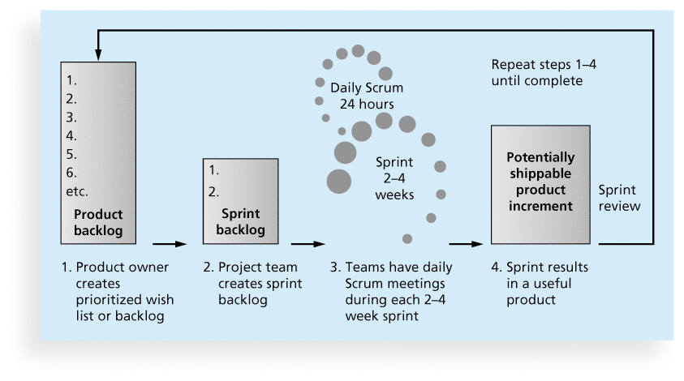
Methodology

Slide 11





Tools
Visual Studio Code v1.15
Gitbash v2.14.3
GitHub
Android Studio v3.0
Firebase

Slide 12




Technologies
HTML5/CSS
Bootstrap v4.0.0
JavaScript v1.8
NodeJS v8.7.0

Slide 13
Entities Involved
Collection Name: cert_database
Sample Data:
{
emailid: john.miller@gmail.com,
firstname: john,
lastname: miller,
imageURL:https://firebasestorage.googleapis.com/v0/b/stude nta89f5.appspot.com/o/All_Image_Uploads%2F15180190335 0.jpeg?alt=media&token=dcad5d7d-8895-458d-b93d-880c
password: John@1234,
}

Slide 14
Entities Involved(Contd..)
Collection Name: admin_details
Sample Data:
{
admin_email: john.miller@gmail.com,
admin_fname: David,
admin_lname : Shan,
password: John@1234,
confirm_password: John@1234,
phonenumber: 6605280506
}

Slide 15
Test case results

Slide 16

Demonstration

Slide 17
Individual Contribution
Amarendar:
Developed login and signup for iOS app along with the firebase database connection to store and retrieve. Working on notifications. Capture image and store them in firebase
Haritha:
Implemented Registration page to insert the data into database and retrieve CERT member details along with the image and display on a web page in a tabular format, static page to send notifications. Tried notifications on ionic app. Working on notifications. Display reports on web page

Slide 18
Individual Contribution(contd..)
Mahesh:
Worked on validations. Working on notifications.
Nithya:
Developed login page for admin which authenticates from the database and also implemented checkbox to select particular members in the table. Worked on validations. Working on notifications
Tilak:
Implemented Pagination, search and sort functionality for the CERT details. Downloading reports. Working on notifications

Slide 19
Individual Contribution(contd..)
Swaroop:
Developed Android application to register into the app (along with profile picture)and store details in firebase database.
Login using email and password using authentication functionality in firebase.
Implemented user validation check to prevent a user with the same email cannot register in the application. Working on notifications.
Storing captured images into the firebase.

Slide 20
Things accomplished in this semester
Gathered Requirements
Login page and signup page for both web and mobile application
Database connection to store and retrieve records
Display CERT member details in a table in web page
Static page to send notification from web
Captured reports from mobile application

Slide 21
Future tasks to accomplish
Send notification from web to mobile app
Create groups based on notification response
Deploy on server

Slide 22
Challenges faced
Choosing the appropriate technologies
Finding appropriate google API’s
Integrating the code
Saving the images to Firebase
Push notifications

Slide 23
Lessons Learned
Technical
Gained knowledge on google API calls, Node.js, Firebase database
Logical thinking
Social
Good communication skills
Team co-ordination

Slide 24
Acknowledgements
We would like to thank
Dr. Mark Corson
Dr. Ajay Bandi

Slide 25


